Slide 1
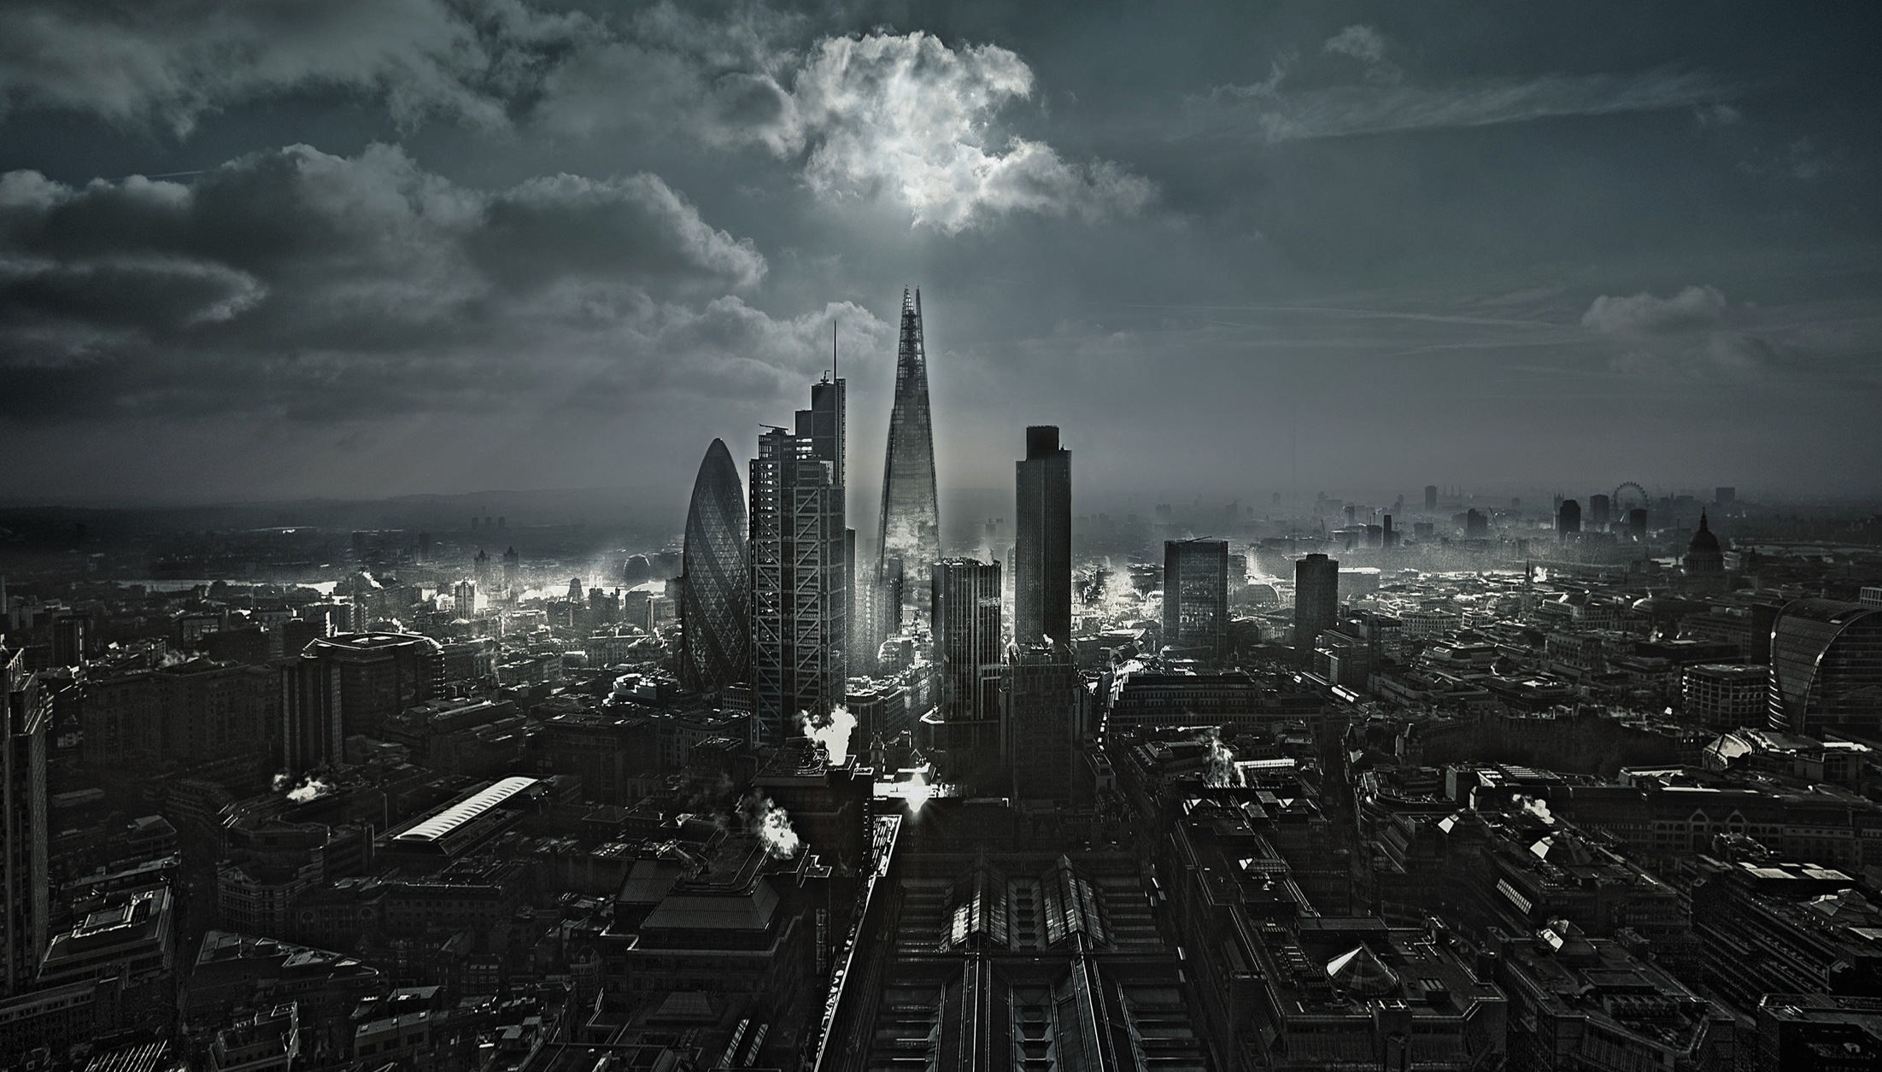
Notes:
IFX has been the fastest growing independent currency firm in Europe with an averaged growth rate of 30%
I have worked in finance since leaving uni in 2011 and have been with IFX for over 2 years, where I am now a Head of Desk and responsible for a team of traders
Like the example company Polycon, we are expanding into new markets and are also vertically integrating in banking, mass payment systems,

Slide 2
The Landmark Hotel, London
IBSA - Annual Conference
Friday 18th November 2016
Guiding the developments of SME clients
Session 5 – Investor Requirements and Financing Techniques
Nick Alfille, Memery Crystal & James Bronte-Stewart, IFX

Slide 3
International Expansion of Polycon
Table of Contents:
Review of potential IPO jurisdictions
An example of a European equity market and the impact of currency
A brief summary of currency movements in 2016
An analysis of varying global Tax policies
Explanation of controlled currencies
Outline of multiple currency cash-flow
Example of the impact of not hedging currency
An analysis of varying global fixed-income rates
Example of the impact of not hedging foreign debt
Overview of the group and various currency flows
A description of a Treasury function
Conclusion

Slide 4
IPO: Selecting an exchange
Stock Market | Headquarters | Founded | Market Cap (USD Billion) | Monthly trade volume (USD Billion) | Credit Rating: S&P, Moody’s & Fitch | Currency
FTSE | London | 1801 | 6,187 | 165 | AA, Aa1, AA | GBP
Euronext | Amsterdam, Brussels, Lisbon, London, Paris | 2000 | 3,321 | 184 | AA | EUR
Deutsche Borse | Frankfurt | 1992 | 1,762 | 142 | AAA, Aaa, AAA | EUR
SIX Swiss Exchange | Zurich | 1995 | 1,516 | 126 | AAA, Aaa, AAA | CHF
BME Spanish Exchange | Madrid | 1831 | 942 | 94 | BBB+, Baa2, BBB+ | EUR
Notes:
“Appropriate jurisdiction for a listed company which wants to clearly demonstrate fiscal transparency and corporate governance”
Access to the single market

Slide 5
The FTSE
Currently >10% above opening rate on June 27th 2016
Directly caused by an increased value of repatriated earnings
Notes:
Regardless of significant geo-political risk and fears of being overblown

Slide 6
Currency markets in 2016
Notes:
Sterling is part of Special Drawing Rights (XDR) by the IMF

Slide 7
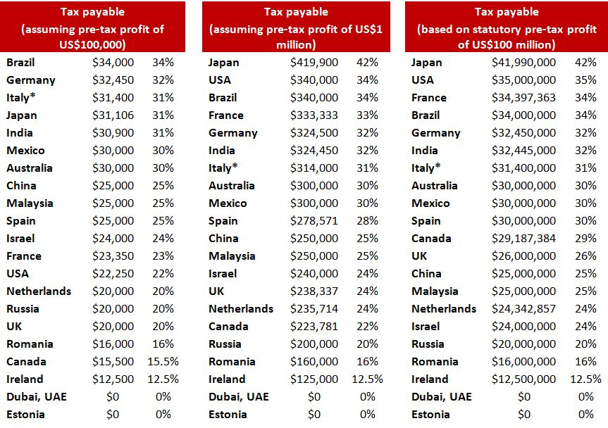
Corporate taxes vary widely between countries
UHY, Corporate Tax Payable per country in US Dollars (highest to lowest) 2016
Notes:
minimum possible withholding tax consequences on distribution of profits” - “tax leakage is minimized”
Tax savings of 2% could be completely irrelevant in today’s currency markets, if the currency s not hedged 2% can be absorbed quickly
Own Chinese Foreign Enterprise Subsidiary (WFE)
Inexpensive region west of Shanghai
Route costs (international NA & SA exports) through the Chinese arm in order to reduce Chinese Tax and currency exposure
CNY exposure (inherent volatility)

Slide 8
Controlled currencies
Foreign exchange controls are various forms of controls imposed by a government on the purchase/sale of foreign currencies by residents or on the purchase/sale of local currency by non-residents.
Angola (Angolan Kwanza - AOA) | Ghana (Ghanaian Cedi – GHS) | Mozambique (Mozambican Metical – MZN) | Ukraine (Ukrainian Hryvnia – UAH)
Armenia (Armenian Dram – AMD) | India (Indian Rupee – INR) | Nepal (Nepalese Rupee – NPR) | Uzbekistan (Uzbekistani Som – UZS)
Bahamas (Bahamian Dollar – BSD) | Iran (Iranian Rial – IRR) | Nigeria (Nigerian Naira – NGN) | Venezuela (Venezuelan Bolívar – VAF)
Cameroon (Central African Franc – XAF) | Sri Lanka (Sri Lankan Rupee – LKR) | North Korea (North Korean Won – KPW) | Zimbabwe (Zimbabwean Dollar – ZWD)
Cuba (Cuban Convertible Peso – CUC) | Libya (Libyan Dinar – LYD) | Samoa (Samoan Tālā – WST)
Ethiopia (Ethiopian Birr – ETB) | Morocco (Moroccon Dirham – MAD) | Sudan (Sudanese Pound – SDG)
Georgia (Georgian Lari – GEL) | Myanmar (Burmese Kyat – MMK) | Tunisia (Tunisian Dinar – TND)
Common foreign exchange controls include:
Banning the use of foreign currency within the country
Banning locals from possessing foreign currency
Restricting currency exchange to government-approved exchangers
Fixed exchange rates
Restrictions on the amount of currency that may be imported or exported
Notes:
Poisoned chalice of high Indian Interest Rates – undertake what is know as a ‘Non-deliverable Forward’ of NDF
Countries with foreign exchange controls are also known as "Article 14 countries," after the provision in the International Monetary Fund agreement allowing exchange controls for transitional economies. Such controls used to be common in most countries, particularly poorer ones, until the 1990s when free trade and globalization started a trend towards economic liberalization. Today, countries which still impose exchange controls are the exception rather than the rule.
Often, foreign exchange controls can result in the creation of black markets to exchange the weaker currency for stronger currencies. This leads to a situation where the exchange rate for the foreign currency is much higher than the rate set by the government, and therefore creates a shadow currency exchange market. As such, it is unclear whether governments have the ability to enact effective exchange controls.^{[1]}

Slide 9
Foreign currency cash-flow
Many new wholesalers who are located in several countries will of course result in multiple currency income streams and therefore requires a comprehensive currency review:
Net position in each currency
Natural Hedge?
Inherent volatility of each currency
Ability to hedge?
Budget rates
Buffer margin
Review cycle (based on time / % deviation MTM / competitors
Forward looking analysis
If listed, which currency does it pay dividends
Consignment Sale Agreement?
Notes:
NB: In October Apple quietly increased the price of their UK products:
MacPro +22%
MacBook +17%
iPhone 7 +12%
German cars manufacturers inversely are now significantly benefitting from ^ USD and –ve EUR (where the cars are produced)
Consignment sale agreements (sale or return) will this affect currency hedges, must keep an eye on demand, unsold stock no longer a EUR incoming, hedges inaccurate
Going to vertically integrate the production channel
Hong Kong – Asian markets, HKD / CNY / (60/40 subsidiary)
New York – North American Market USD / CAD? Donald Trump
Rio De Janeiro – South American Market BRL / VZP / MXN Economics

Slide 10
EasyJet PLC
Recently announced:
An expected currency hit of £90M just this year
Profit fall of 30% from £686M in 2015 to £495M this year
Fuel costs on average constitute 29% of operating expenses (USD)
Notes:
IPO – GBP Dividends
Fall in Profit
Reduced Dividend
Reduced share price

Slide 11
Nick Alfille, Memery Crystal - Characteristics / Advantages of Loans - Currency
The global bond market has had an impressive with yields in many developed economies in a ‘race to the bottom’, there is currently around $13T in negative yielding bonds.
Low-yield jurisdictions High-yield jurisdictions
Country | Interest Rate
Switzerland | -0.75%
Denmark | -0.65%
Sweden | -0.50%
Japan | -0.10%
Eurozone | 0%
United Kingdom | 0.25%
Country | Interest Rate
Argentina | 27%
Brazil | 14%
Russia | 10%
India | 6.25%
Mexico | 4.75%
China | 4.35%
NB: accessing foreign fixed income, should only be undertaken following a comprehensive review of the currency and a serious consideration of hedging
Notes:
Indian currency is a controlled currency, the RBI do not allow anyone to hold it for more than 4 days
Also CNY / ZAR have previously been difficult to get out of the country, if you don’t have the necessary knowledge

Slide 12
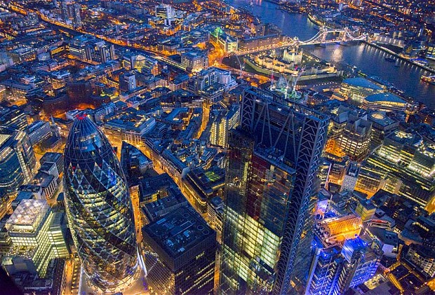
The Gherkin receivership, 2014
IVG Immobilien AG & Evans Randall purchased in 2007 for almost £600m (€729m, $1bn)
Partially paid through a 15-year loan, some which was in Swiss francs (CHF) when GBPCHF 2.4814
CHF strengthened drastically on the pound, almost 63%, causing a break in the loan-to-value threshold
The buyers had been defaulting on their £400m loan since 2009 because of interest rates.
End of 2013, IVG filed for insolvency in a German court, had amassed over €4bn in debt.
Firm survived as private fund division was purchased by Deutsche Fonds Holding AG in March.
Although Deutsche Fonds Holding AG suffered the same fate under a strengthening CHF

Slide 13
Polycon Lens Company
Operational flow
STEPHEN HOLMES
WAREHOUSE
Domestic currency overheads
EYEMAX
GROUP HOLDINGS
(Group holding ccy)
External finance
(Which ccy)
Delivery of
Spectacle Lenses
EYEMAX
FINANCE COMPANY
WER
Transport & Storage of Spectacle Lenses
EYEMAX CORP
(manufacturing)
AGENT
Hong Kong
60%
40%
EYEMAX.COM
LTD
Channel Islands
Guernsey / Jersey Pound 1:1
SALES COMPANY
Brazil
Barzilean Real (BRL)
SALES COMPANY
USA
USD Dollar (USD)
MANUFACTURING COMPANY
Hong Kong
Hong Kong Dollars (HKD)
SALES COMPANY
Hong Kong
VIZITECH HOLDINGS LTD
Sales of Lenses for Digital Cameras
E-Commerce sales
EYEMAX CORP.
(Digital Camera Manufacturer)
FOREIGN ENTERPRISE SUB China
Chinese Yuan (CNY)

Slide 14
Treasury Function
The Treasury function will then be responsible for:
Planning and Operations
Cash and Liquidity Management
Funding and Capital Markets
Financial Risk Management
Corporate Governance
Stakeholder Relations
Notes:
Net group cash-flows
Repatriating surpluses and subsidising deficits in currency
Sourcing debt in low yielding markets
Distributing surplus funds to high yield markets – although they are likely to fund Joint Venture Possibilities (40x return
http://support.treasuryview.com/kb/treasury/treasury-function-overview

Slide 15
Conclusion
Expanding into new markets is a incredible opportunity, however it is fraught with threats
Success derives from a careful analysis of all moving parts
Tax
Currency
Political Stability
Barriers to trade
Transport costs
With financial market volatility at all-time highs, hedging where possible is required to protect the bottom-line

Slide 16
James Bronte-Stewart
Head of Desk
DDI +44 (0)20 3301 0662
Email jstewart@internationalfx.com
Web www.internationalfx.com

