Slide 1
SESSION 1
IDENTIFICATION, PROTECTION AND EXPLOITATION OF INTELLECTUAL PROPERTY RIGHTS
STEPHEN HOLMES
WAREHOUSE
Transport & Storage of Spectacle Lenses
Delivery of Spectacle Lenses
POLYCON
LENS COMPANY
(manufacturing)
Sale of Spectacle Lenses
WHOLESALERS
WORLDWIDE
POLYCON IPR
LOW-TAX STATE
(Brand & Product Owner)
SALES COMPANY
(Storage/Sale of Telescopic Lenses)
POLYCON
INT. LICENSING
HIGH-TAX STATE
Third Party Licensing & Franchise Agreements

Slide 2
“Identification, protection and exploitation of IP rights (How not to patent your copyright)”

Slide 3
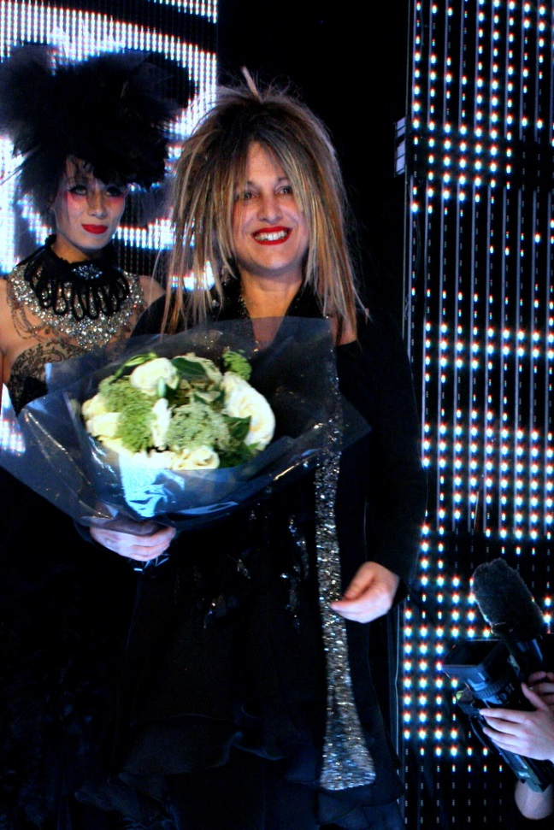
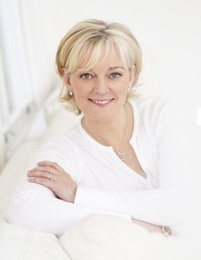
Who are these people and what do they have in common?

Slide 4
Answers
“Elizabeth Emanuel: "This time, I'm doing it all properly"
After losing her name in the Nineties, the designer Elizabeth
Emanuel is preparing to make her comeback. She discusses
business plans, perfect weekends and her famous hair
extensions.” (Daily Telegraph, 2014)
“The business Malone is best known for, Jo Malone London, is now owned by Estee Lauder. She sold it for an undisclosed amount in 1999, staying on as the creative director until 2006. In 2011, she introduced Jo Loves.” (Financial Review, 2016)
“Karen Millen loses legal dispute against womenswear retailer.” (Fashion United, 2016)

Slide 5
Yes, they no longer have the right to use their name
Elizabeth Emanuel sold her trade mark to a business which went bust and then sold it on. She tried and failed to get the trade mark back in court proceedings.
Jo Malone willingly sold her business to Estee Lauder and trades as Jo Loves.
Karen Millen had agreed not to use her name when selling rights to an Icelandic bank and then failed in a challenge to the agreement.

Slide 6
How Polycon stop this happening (if it wants to):
Identify IP rights.
Protect them by registration where possible.
Licence them or sell them.

Slide 7
IP – a whistle-stop tour
Trade marks
Copyright
Passing off
Patents
Designs

Slide 8
Polycon’s Trade marks
Can be registered or unregistered.
Can cover the UK, the EU and many other territories.
Can cover anything from chemicals to plastic lenses.
A registered trade mark gives a monopoly.
An unregistered trade mark gives a right to prevent use and (sometimes) registration.
Can be words, logos, signatures, photos, smells, colours….

Slide 9
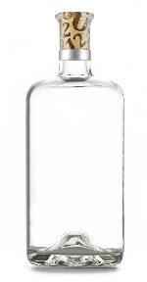
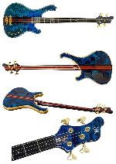
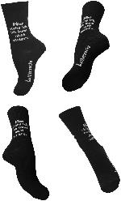
Trade marks - examples

Slide 10
Polycon’s Copyright e.g. marketing materials
Cannot be registered (in the UK).
Comes into existence automatically.
Generally belongs to the “creator”, unless the work is created in the course of employment.
It is a right to prevent copying.
Applies to “artistic works” including photographs, art, books, music…

Slide 11
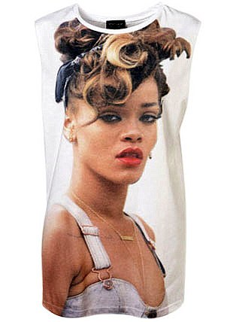
Passing off Polycon’s lenses as one’s own brand
Unique to the UK.
A “common law” right, i.e. there is no statute.
Requires a reputation/goodwill, misrepresentation and damage.
Can be hard to prove.
Huge body of case law, e.g. Rihanna v Topshop.

Slide 12
Polycon’s acrylic lens patents
Must be novel.
Must not have been made public anywhere.
Always do a search before proceeding.
Do not disclose without confidentiality agreement.
Can be expensive.
Can be lucrative.

Slide 13
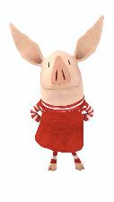
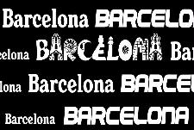
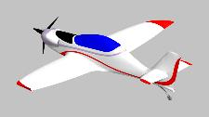
Polycon’s designs
Can be registered or unregistered.
Can be registered in the UK, in the EU and beyond.
Are generally cheap and easy to obtain.
Can be hard to enforce.

Slide 14
Best practice
Registered rights give the strongest form of protection – they are monopoly rights.
Take advice on which individual or company should own the rights – tax issues.
Time and money spent on searches before launch is a good investment.
Look to the future – think broad.
Derive income through licensing as owner of the IP rights.
The more registered rights, the greater the value (probably).

Slide 15
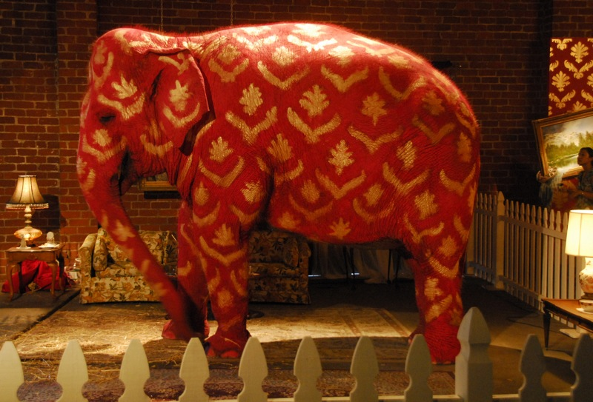
Brexit

Slide 16
Questions?
+44 (0)20 7936 8861
chris.mcleod@elkfife.com
www.elkfife.com
© Elkington and Fife LLP 2016

